Slide 1
Insurance fraud analysis
Chris Zhang
Notes:
Introduce myself.
My name is Chris. I am responsible for this analysis. In the next 20 minutes I will go through the process and the findings from this analysis.

Slide 2
plan
Background
Outline of the problem
Visual Analysis
Data preprocessing / feature engineering / visualization / exploratory modelling / feature selection
ML Model analysis
Explore various basic types of ML models to determine further modelling directions
recommendations
Provide recommendations on next steps to produce productionable model
Notes:
My presentation is in the next 4 stpes

Slide 3
Background
What is the problem?
Vehicle insurance fraud involves conspiring to make false or exaggerated claims involving property damage or personal injuries following an accident.
How:
Using
Sample data set of 1000 auto incidents and claim.
Goal:
Detect Fraud
Notes:
So what is the problem….

Slide 4
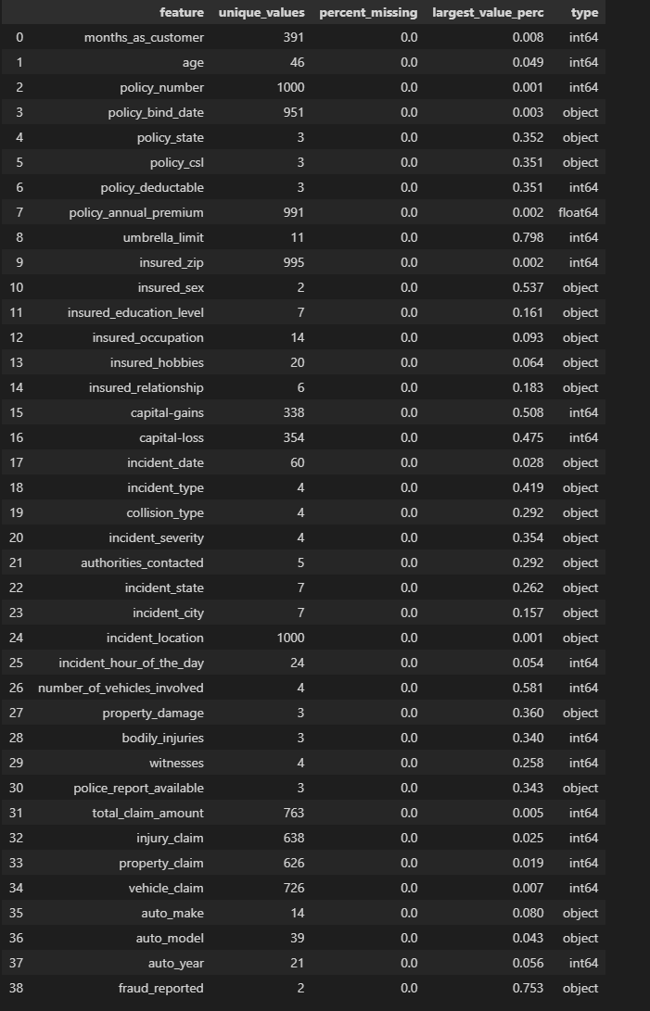
Data
Size
Features
1000 rows
39 Columns
20 nominal / categorical
18 numerical
1 Target
Data quality
No null values
No errors
No duplicates

Slide 5
Data Preprocessing
Features to remove
policy_number
- as it is an identifier only
incident_location
- as each piece of data have an unique location. It is not useable as a categorical information in current state. To make it useable, it would need to have to be spatially analysed. This is beyond the scope given the resources of this project.
insured_zip
- this is removed as it is an identifier for where the policy holder live. While it doesn't hold enough value in itself. However if linked to the demographics of the area, then it might be a better feature. E.g. To see if how well off the suburb and its relation to the data. It is beyond the scope of this project.

Slide 6
Data Preprocessing
Features to re-engineer
'policy_length' = number of days from 'policy_bind_date' to 'incident_date'
Makes more sense to use the dates rather than on their own, looking at the amount of time between the policy is taken out and the incident time.
Those features are removed since the information is contained within
policy_csl have been converted into two components, lower and upper, those numbers may have information contained that helps the analysis. So they are split out into two additional variables

Slide 7
Data Preprocessing
Cleaned
Converted
Impossible value remove
- incident_severity
- inherit ranking in the data. Set to ordinal.
- policy_csl
- policy_csl have 3 categories that have inherit ordinal value to them. Hence converted.
- insured_education_level
- education level have inherit ranking, converted to ordinal
- umbrealla_limit
- umbrella limit cannot negative. Any negative values is probably an error and converted to its absolute value.
- capital-loss
- capital loss is mostly represented as negative. This is converted to its absolute value.
'?' was used to indicate as a third category from 'yes and 'no' in some of the columns. 'unknown' is imputed in its place as '?' may cause problems.
- collision_type
- police_report_available
- property_damage

Slide 8
Data Preprocessing
More to do
Analyse the location of the accident, road conditions, traffic conditions.
This would require spatial analysis linking in map data to give more characteristics to the accident site.
Analyse the location of accident
How far from the place of resident? Perhaps the distance yield further information on likelihood of fraud.
Time analysis
Create variables such as days of week, public holidays, against when the insurance is purchase and when the incident happened

Slide 9
Visual Analysis

Slide 10
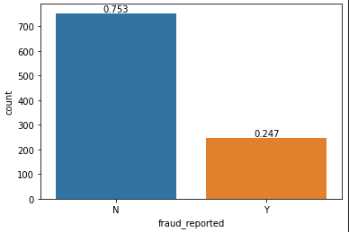
Target variable
Fraud_reported
247 Fraud Cases / 1000 total cases
Imbalanced dataset
This would affect the training of the model
Techniques to unbalance would be needed

Slide 11
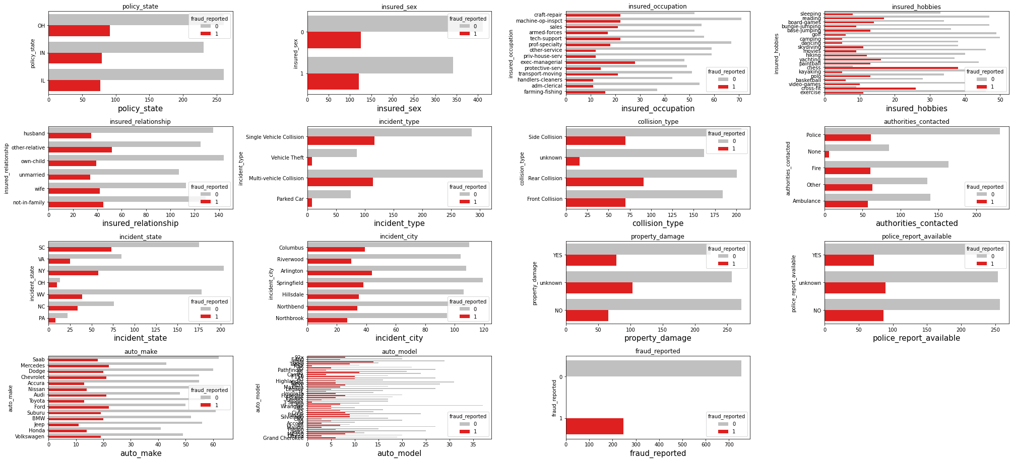
Categorical variables

Slide 12
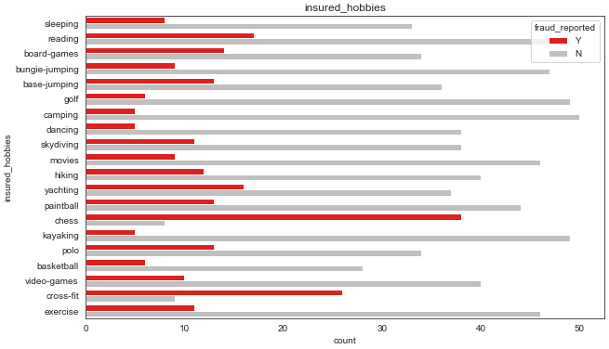
Categorical variables

Slide 13
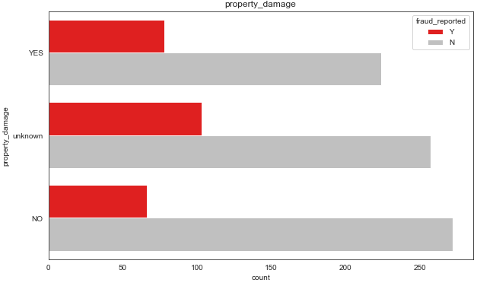
Categorical variables

Slide 14
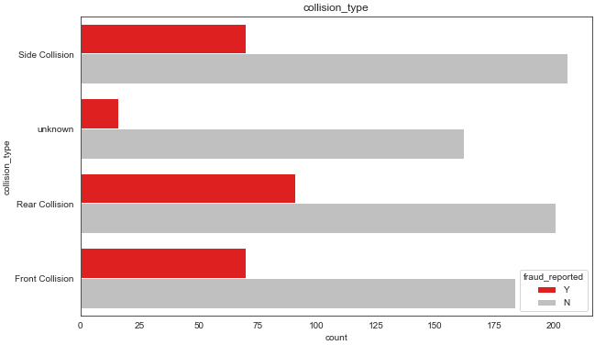
Categorical variables

Slide 15
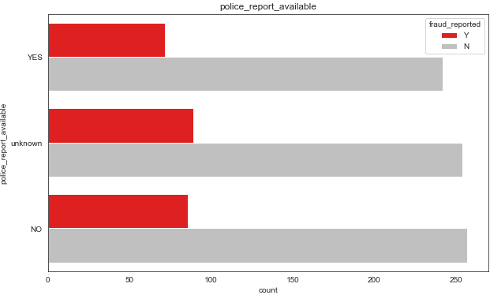
Categorical variables

Slide 16
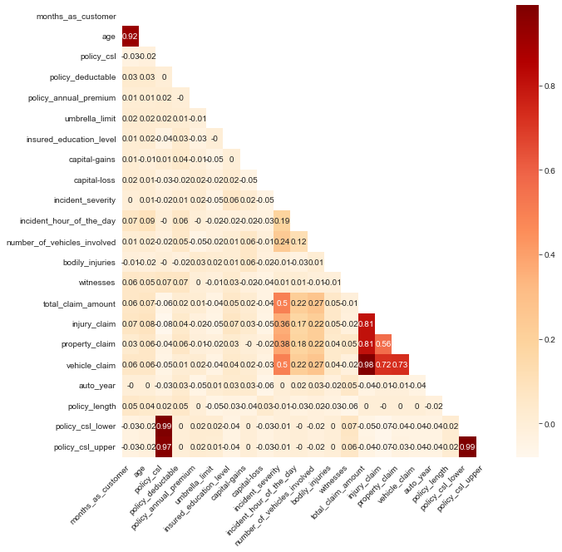
Continuous variables

Slide 17
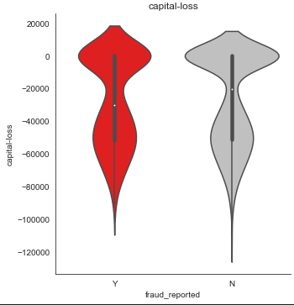
Continuous variables

Slide 18
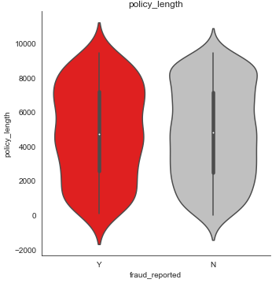
Continuous variables

Slide 19
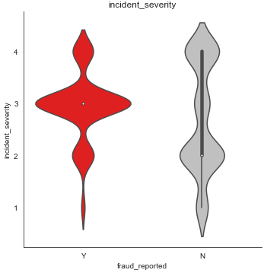
Continuous variables

Slide 20
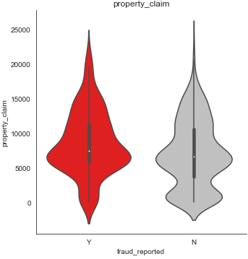
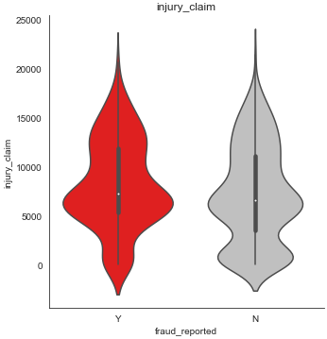
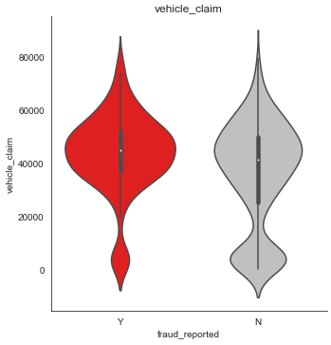
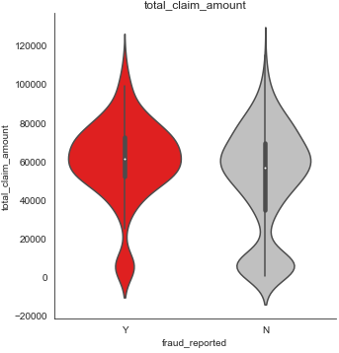
Continuous variables
Total Claim
Injury Claim
Vehicle Claim
Property Claim

Slide 21
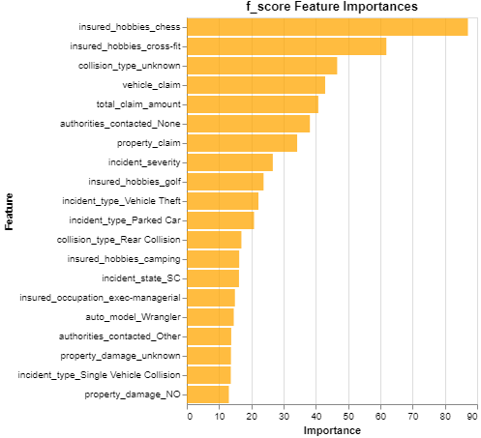
Advanced Analysis
Random forest features selector
Random forests are one the most popular machine learning algorithms.
They are so successful because they provide in general a good predictive performance, low overfitting, and easy interpretability.
This interpretability is given by the fact that it is straightforward to derive the importance of each variable on the tree decision. In other words, it is easy to compute how much each variable is contributing to the decision.

Slide 22
ML model Analysis

Slide 23
Basic models to determine suitability of data
Logistic Regression
Regression based model
K Nearest Neighbours (KNN)
Distance based model
Naïve Bayes
Bayesian probability-based model
Random Forrest
Decision tree-based model

Slide 24
Modelling
How the models are ran
Data is split into training and test.
10 fold random search cross validation is used on the training data set
Optimised to maximised the ‘roc_auc’ score
ROC curve (receiver operating characteristic curve) is a graph showing the performance of a classification model at all classification thresholds. By maximising the area under the curve (auc), we can ensure the model’s performance is optimised.
ROC curve is plotted against the test data set
Confusion matrix is visualised to see how well the model identifies the true and false positives

Slide 25
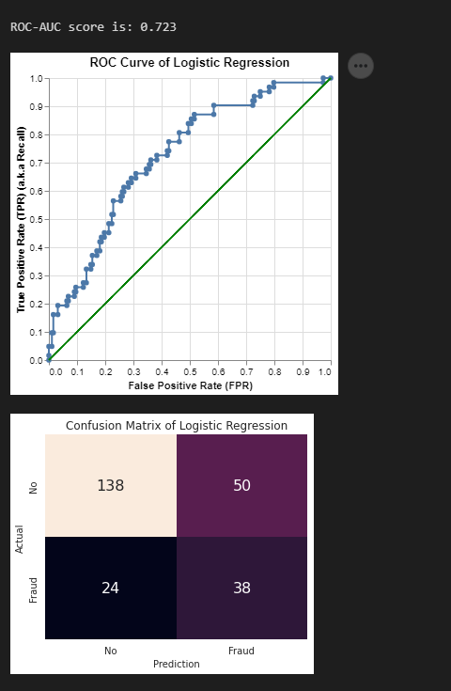
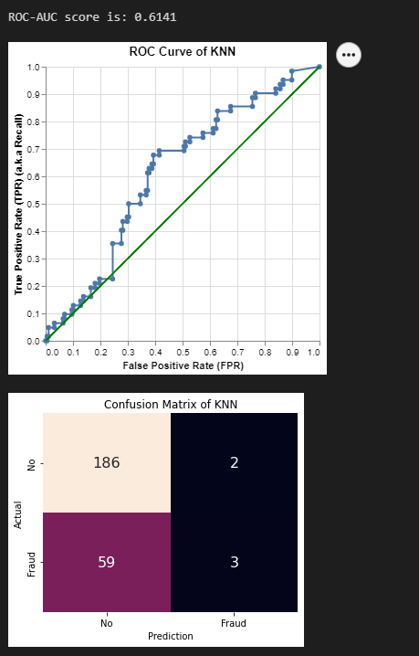
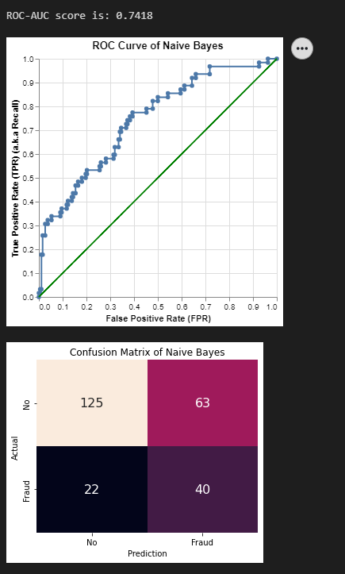
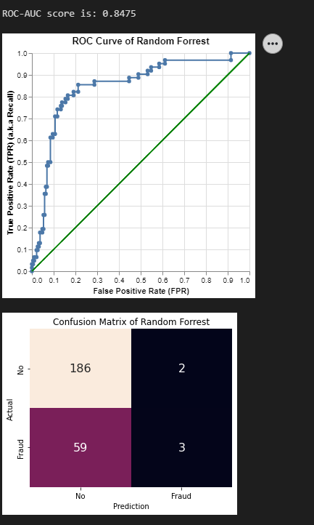
Logistic Regression
KNN
Naïve Bayes
Random Forrest

Slide 26
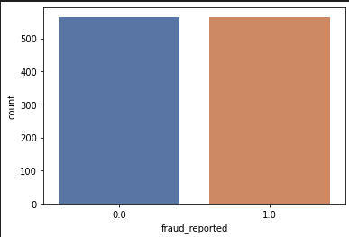
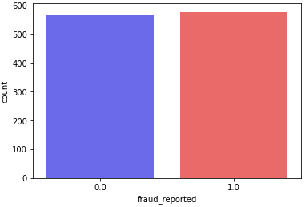
SMOTE
ADASYN
Control
ADASYN (Adaptive Synthetic) is an algorithm that generates synthetic data, and its greatest advantages are not copying the same minority data, and generating more data for “harder to learn” examples.
ADASYN does is same as SMOTE just with a minor improvement. After creating those sample, it adds a random small value to the points thus making it more realistic.

Slide 27
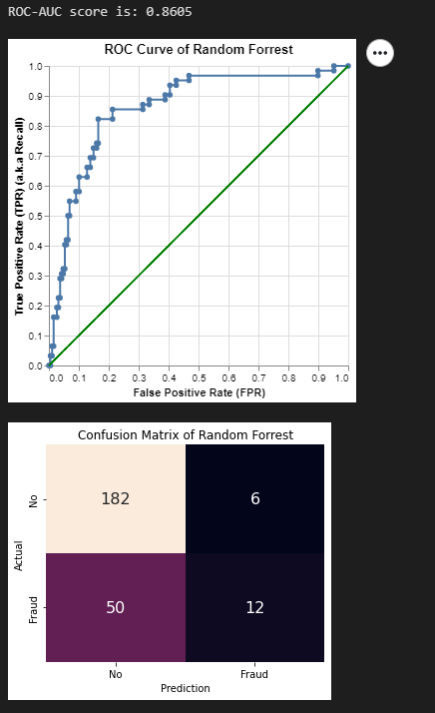
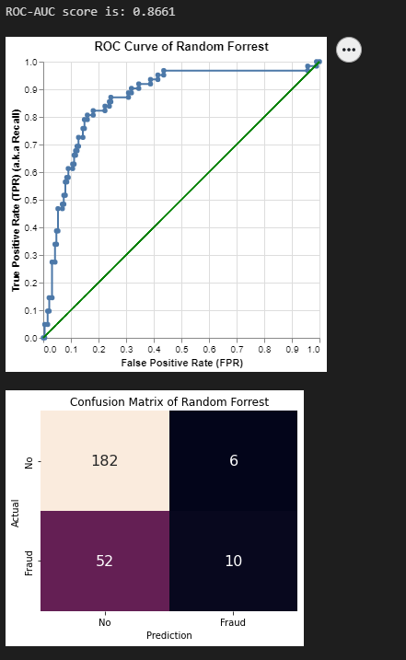
Random Forrest
Control
SMOTE
ADASYN

Slide 28
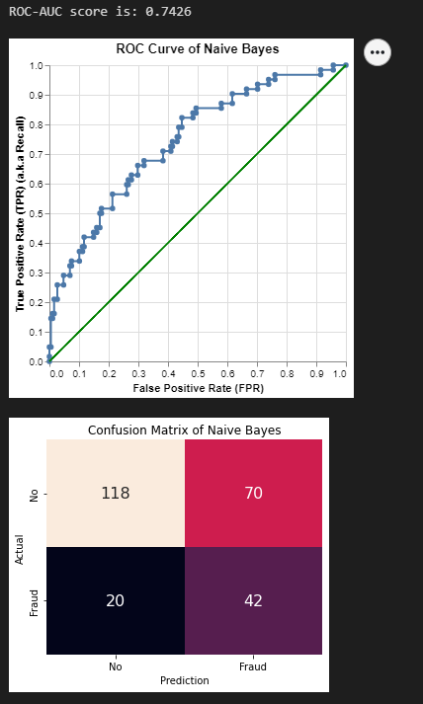
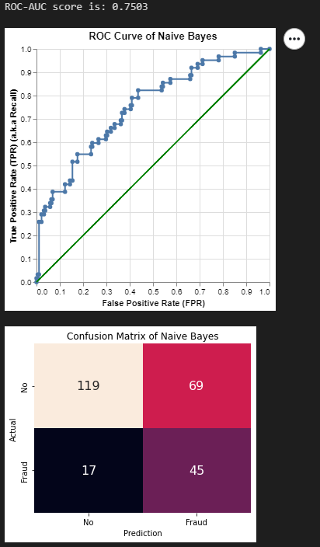
Naïve Bayes
Control
SMOTE
ADASYN

Slide 29
recommendations
Cool and stylish product
Areas for community connections
Online store and market swap

Slide 30
Additional features
Spatial
Looking at the location of the holder versus the location of the accident
Surrounding areas of the accident. Is it on a straight road or corner etc
Time
Looking at creating features such as day of the week, or holiday periods. Maybe people who have an accident during weekends are more likely to commit fraud.
Payment behavior
It is not apparent in the dataset if the client pays their premium on time. Fraud claims may be the result of their financial situation.
Generate additiona components
Perhaps using statistical methods such as Principal Component Analysis (PCA) can improve the performance of model. However, that makes the model harder to explain and may over complicate things.

Slide 31
Modelling
Balancing out the training data
Model | roc_auc score
Logistic Regression | 0.7230
KNN | 0.6141
Naive Bayes | 0.7418
Random Forrest | 0.8511
Logistic Regression SMOTE | 0.7049
KNN SMOTE | 0.6057
Naive Bayes SMOTE | 0.7365
Random Forrest SMOTE | 0.8753
Logistic Regression ADASYN | 0.7056
KNN ADASYN | 0.5575
Naive Bayes ADASYN | 0.7271
Random Forrest ADASYN | 0.8699
Balancing out the dataset using oversampling have improved the performance of the predictions. Worth further exploration
Model type selection
Decision tree based model perform better in picking out the not fraud. While probability based models perform better picking out the frauds.
Advanced modelling
Explore the advanced types, e.g. XgBoost, Adaboost for decision tree based. For probability based, SVN, Bernouli Naïve Bayes etc
Using a combination of the model and combining together using methods such as bagging and ensembling to improve analysis results.

Slide 32

THANK YOU

